Slide 2

Total Waste

Slide 3

Total Waste
42,8%

Slide 4

Total Waste
42,8%
17,2%

Slide 5


Slide 6

How to counter :
Efficiently motivating citizens to recycle
Creating a token-reward system using
Blockchain tech
(on the Etherium platform)

Slide 7
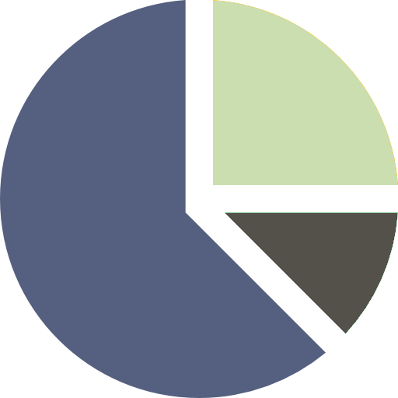
How to counter :
Ensure accurate statistics

Slide 8
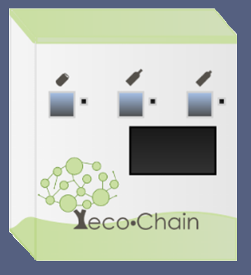
eco•Bin
1,80 m
1 m
2,10 m

Slide 9
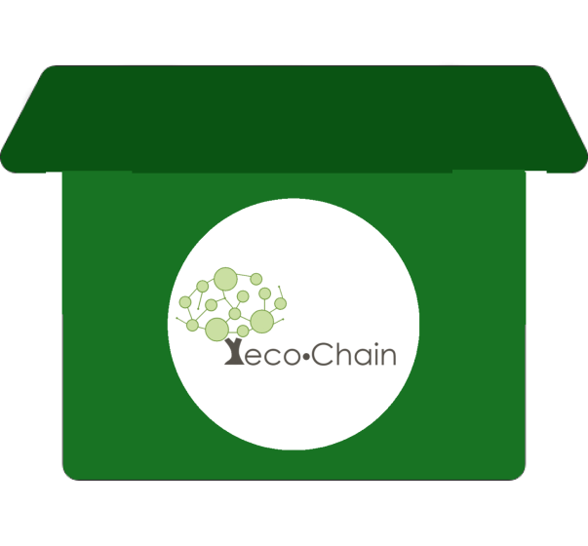


Slide 10

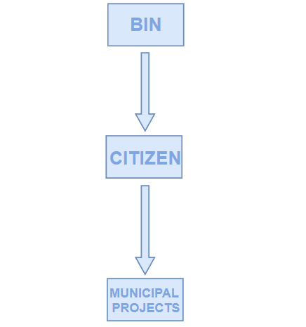

Tokens

Slide 11

Income
Selling & Maintaining eco•Bins
eco•Bins construction fees: 750€ per item
eco•Bins selling price: 1000€
eco•Bins Maintenance : 25€/per month

Slide 12
Why to invest in eco•Chain
Citizens have influence over shaping their city
Increase in Percentage of Recycling
eco•Bins can
incorporate technology

Slide 13
Τhank You
Nίκος Γιαχούδης Λυδία Νέγκα
Γιώργος Γκέτσιος Ιάσων Μεϊδάνης

